Slide 1
Getting started with AWS Educate Classroom
Resilient Distributed System
Fall 2019

Slide 2
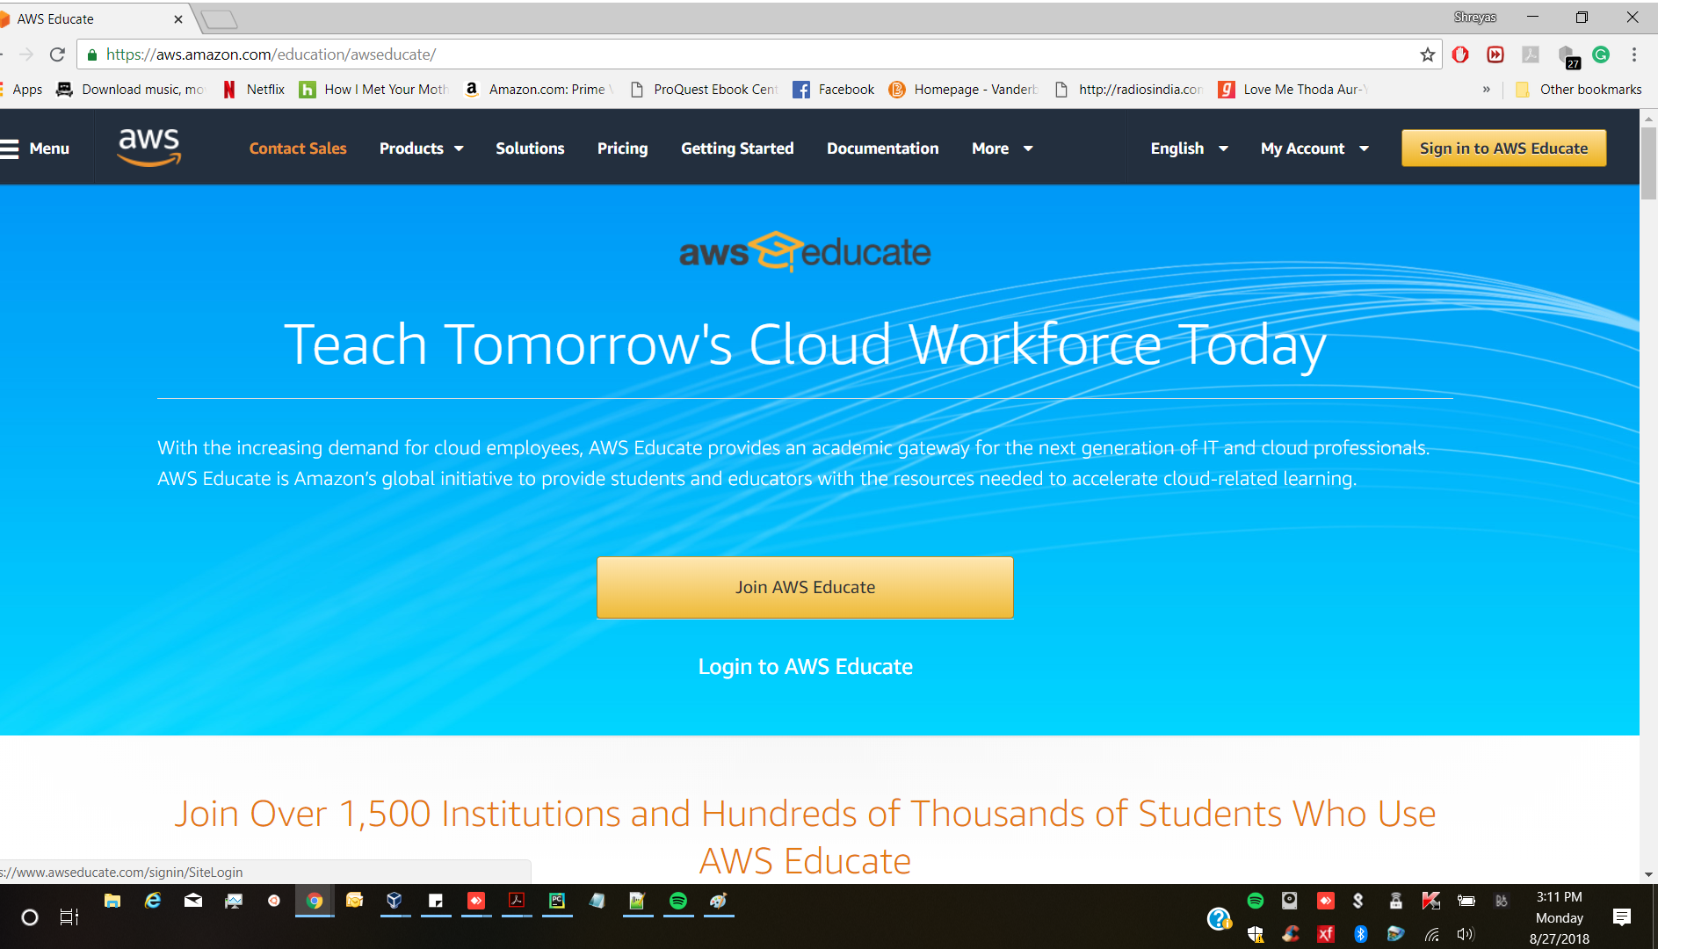
AWS Educate Landing Page
https://aws.amazon.com/education/awseducate/

Slide 3
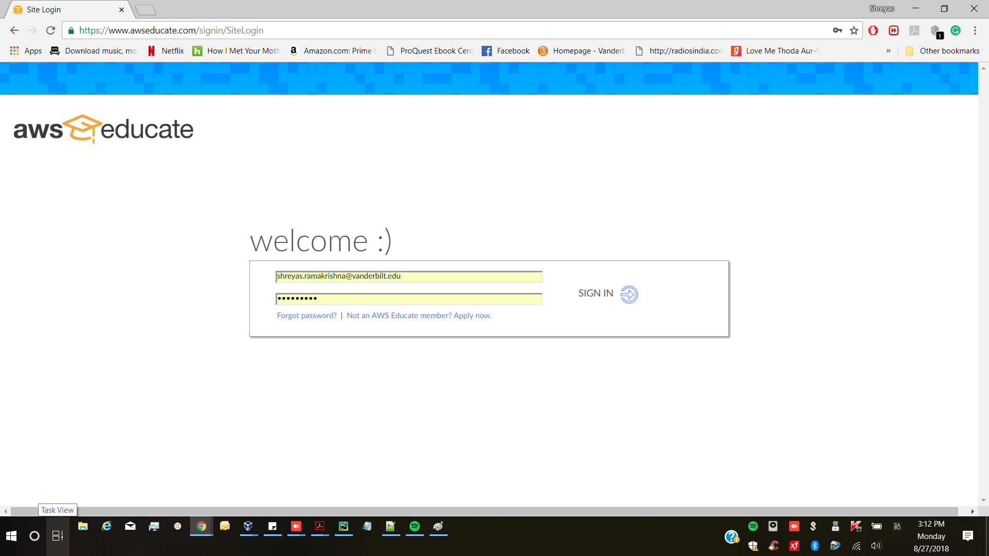
Sign into AWS Educate
After you have clicked on “Sign into AWS Educate”. It will land you into the page shown below.
Here use your login details and click on “sign in”

Slide 4
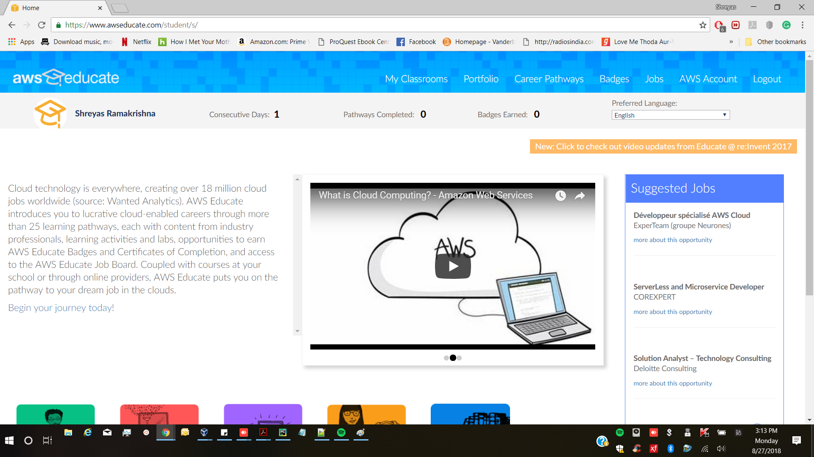
My classroom
After signing in into aws educate, you will land into the page shown below.
Here you need to click onto “My Classrooms”

Slide 5
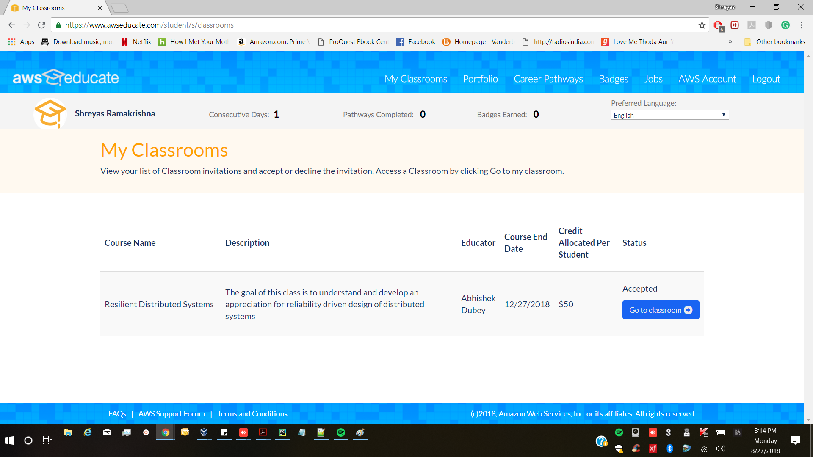
My classroom
Once you click on “My Classrooms”, you will get into the page below.
You must have got the request from the professor to join the classroom.
You will be getting $50 credit with this account.

Slide 6
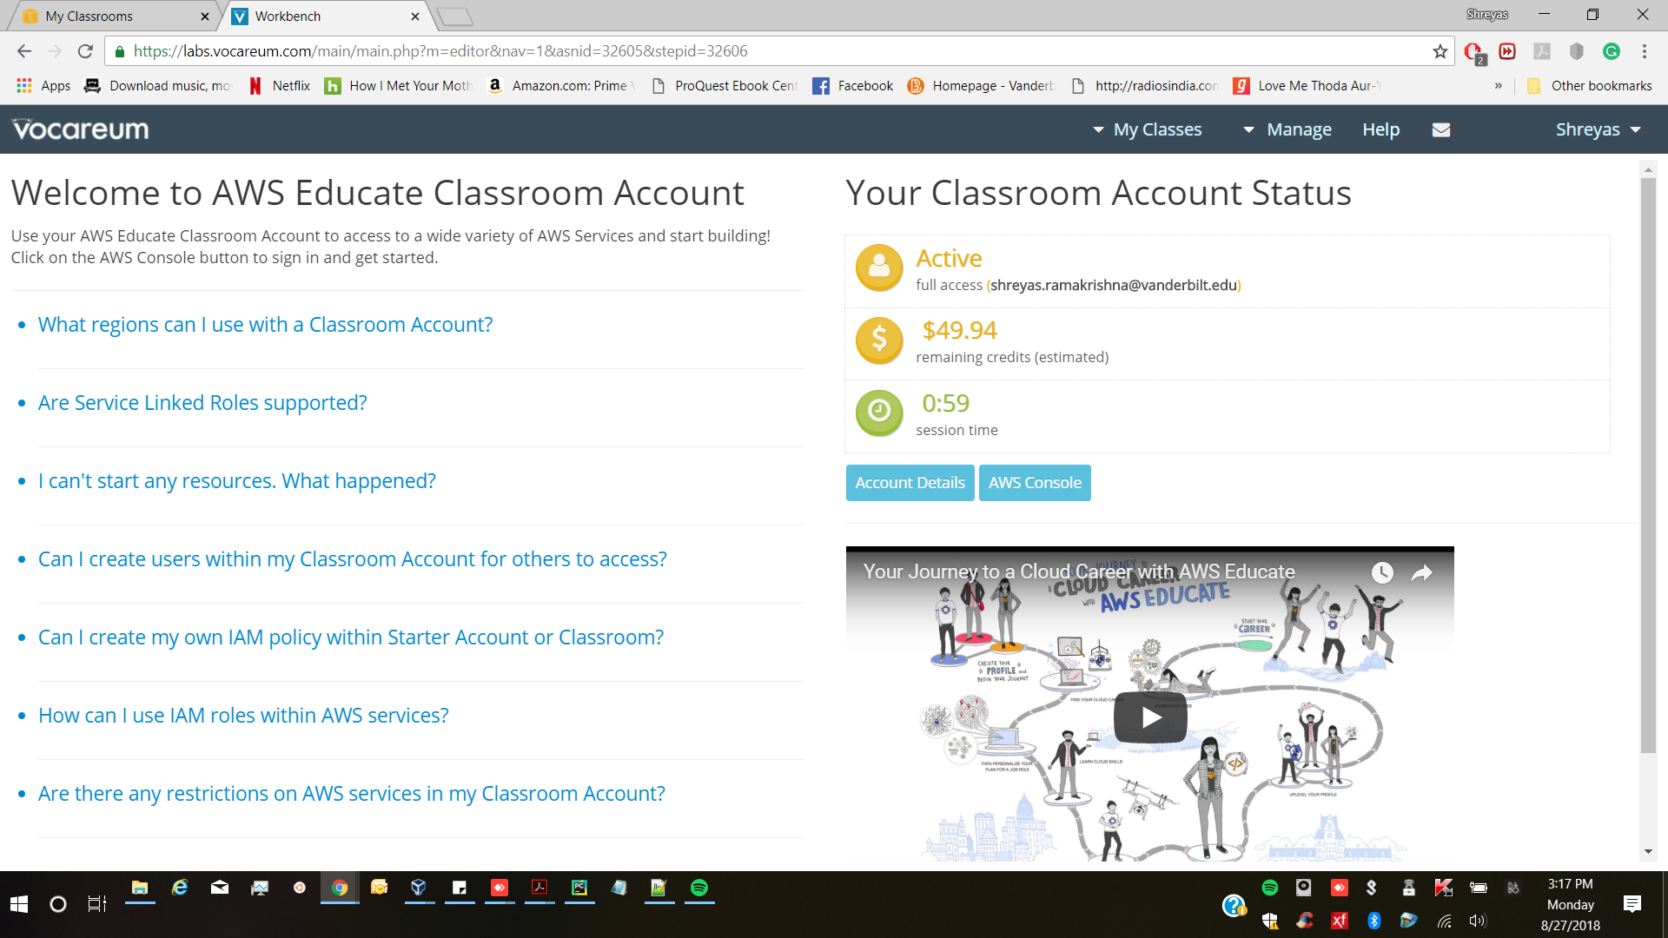
Go to classroom
Once you click on “Go to Classrooms”.
You will be asked to continue. Just click on continue.
This will open a new tab with Vocareum workbench.
Now click on “AWS Console”.

Slide 7
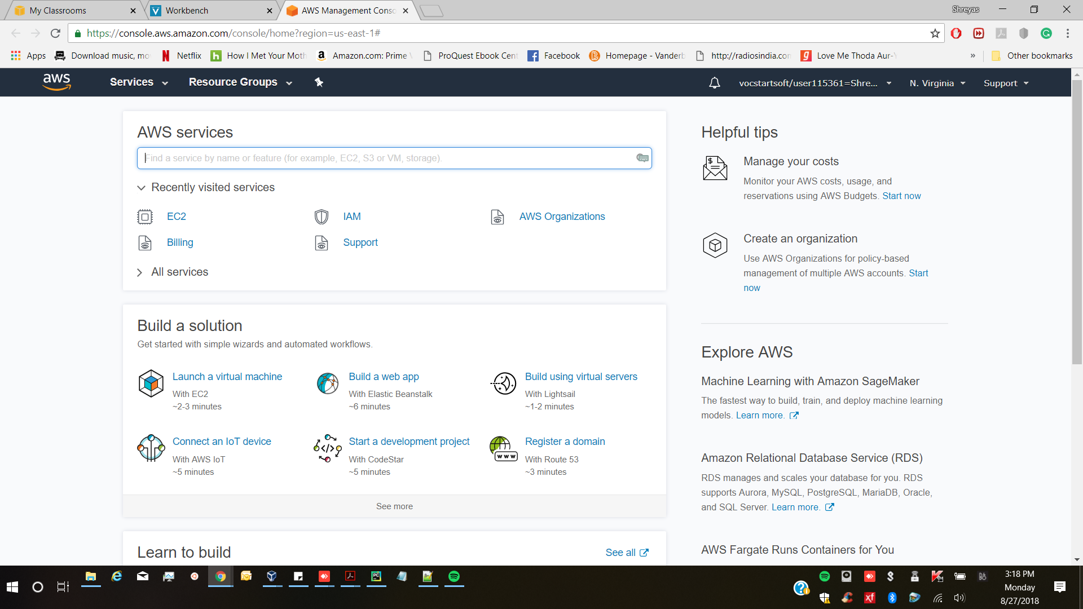
AWS Service Page
Clicking on “AWS Console” will land you into the AWS services page.
This is the page where you can actually begin using the AWS services.
For the course we will use EC2 instance. Please click on it.

Slide 8
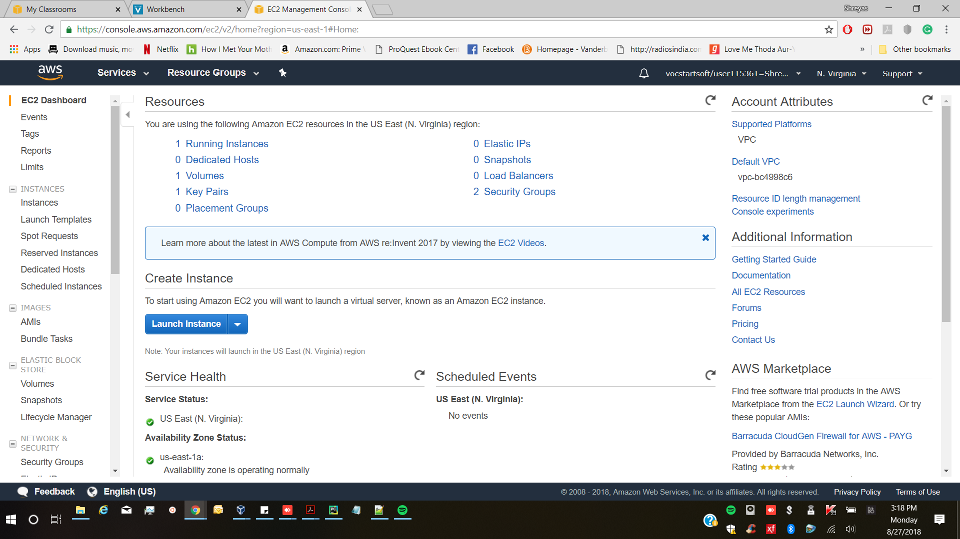
EC2 Dashboard
Selecting “EC2” will lead you to the EC2 dashboard.
You can see information about running instances, IP address’s, etc.
Once here, we can create our first instance

Slide 9
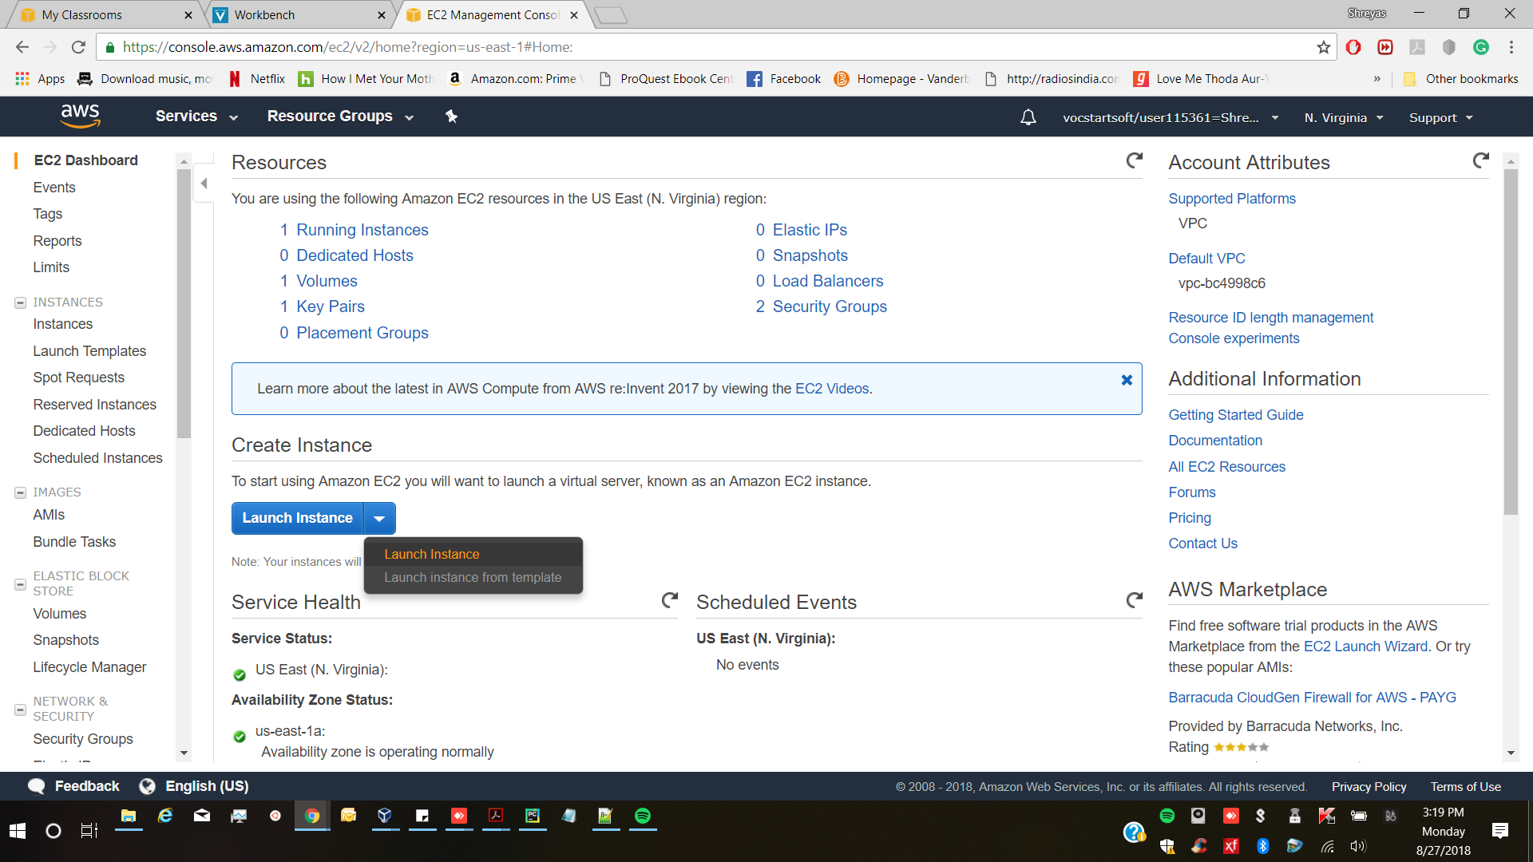
EC2 Dashboard
Selecting “EC2” will lead you to the EC2 dashboard.
Here click on “Launch Instance”. (I already have one instance running, so it shows 1 running instance, if you are creating your first, then it will be 0)

Slide 10
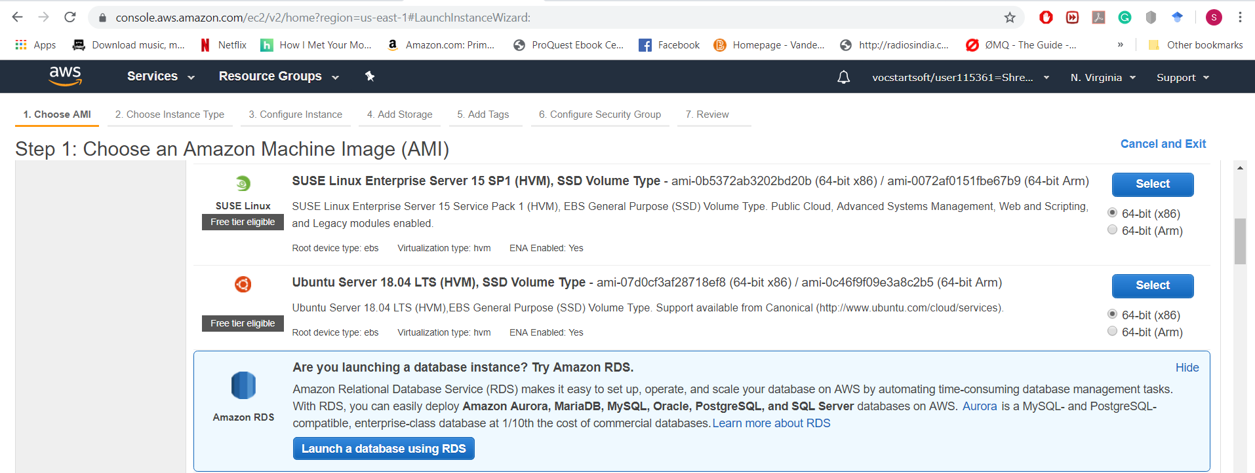
Choose your instance type
First step is to choose the type of instance. This varies with your application.
For the course you can select the “free tier Ubuntu server 18.04” instance.

Slide 11
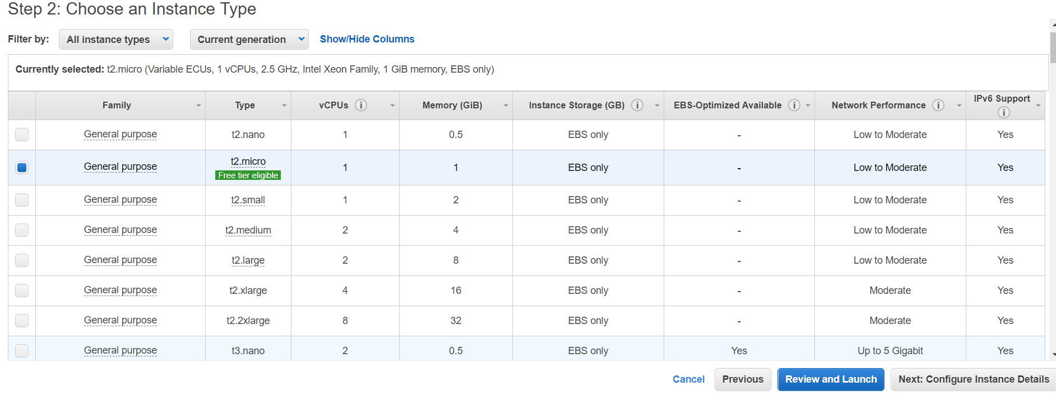
Choose your instance type
This shows all the available “Ubuntu” instance type.
Here just select the default “t2.micro” instance. It is under free tier.
Click on “Next: Configure Instance Details”.

Slide 12
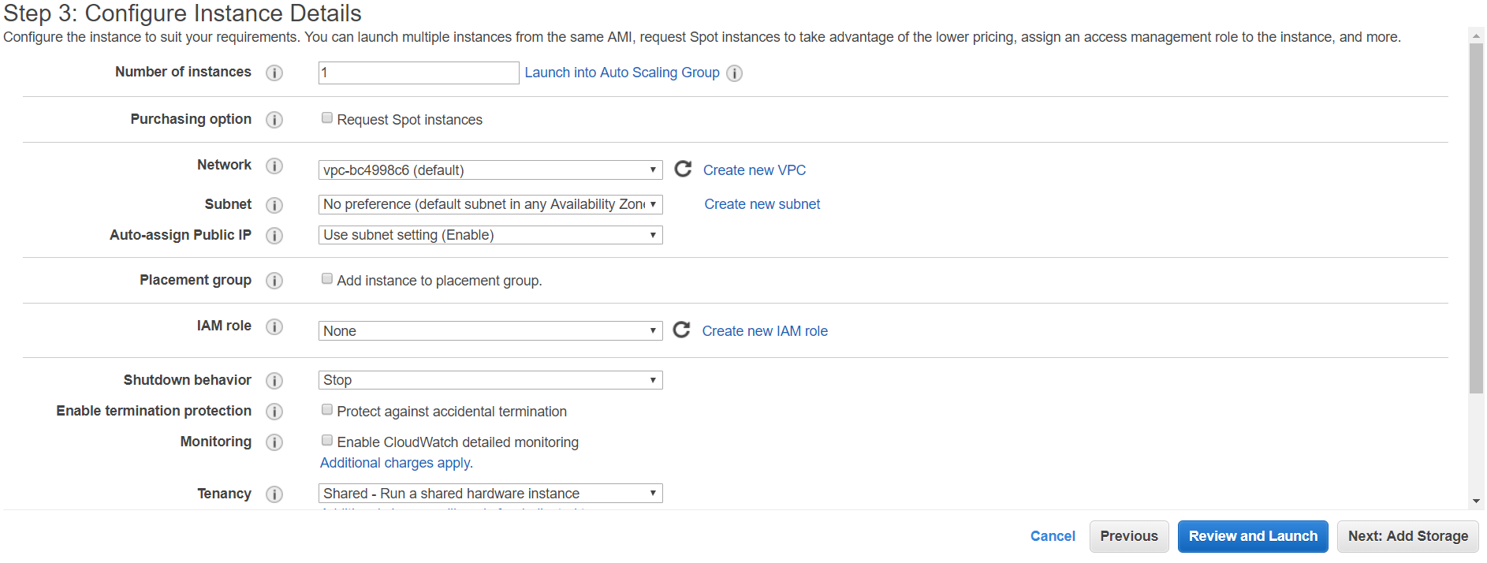
Configure Instance Details
Just leave this as it is.
Click on “Next: Add storage”
Select the number of EC2 instances you want.

Slide 13
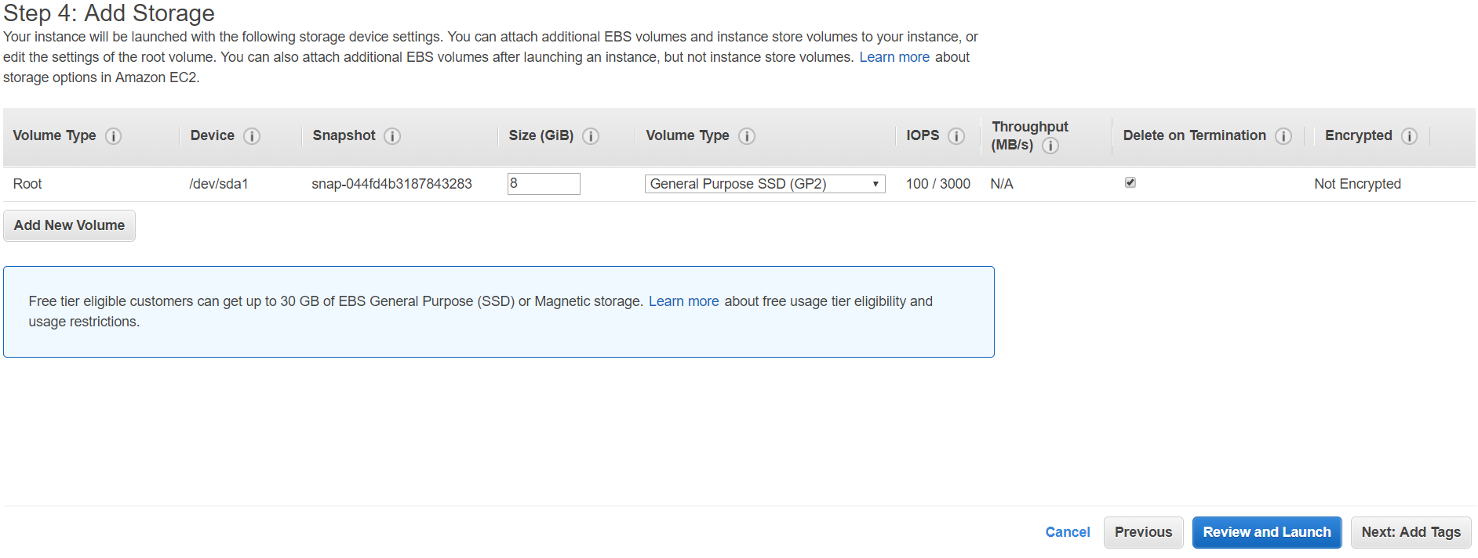
Add Storage
Just leave this as it is. We can use the basic instance for our assignments
Click on “Next: Add Tags”

Slide 14
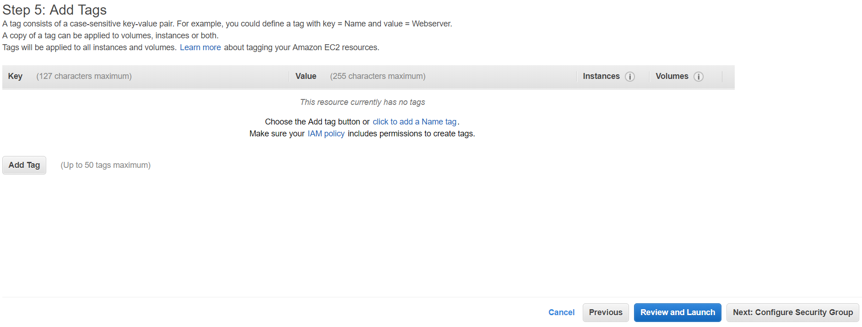
Add Tags
Just leave this as it is.
Click on “Next: Configure Security Group”

Slide 15
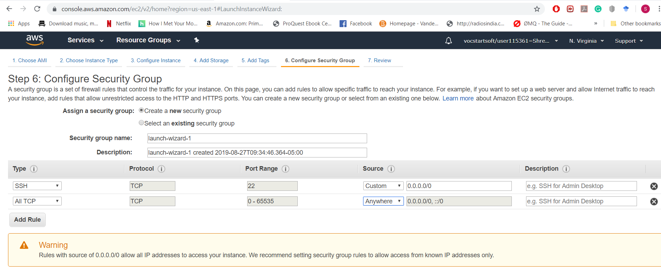
Configure Security Group
Here you can add “ALL TCP” from your IP and any other address to be accessing the Instance. This will open up all the TCP ports.
SSH TCP Port 22 for ssh access.
For now you add these two to your security group.
You can make changes later depending upon your application.
Click on “Next: Review and Launch”

Slide 16
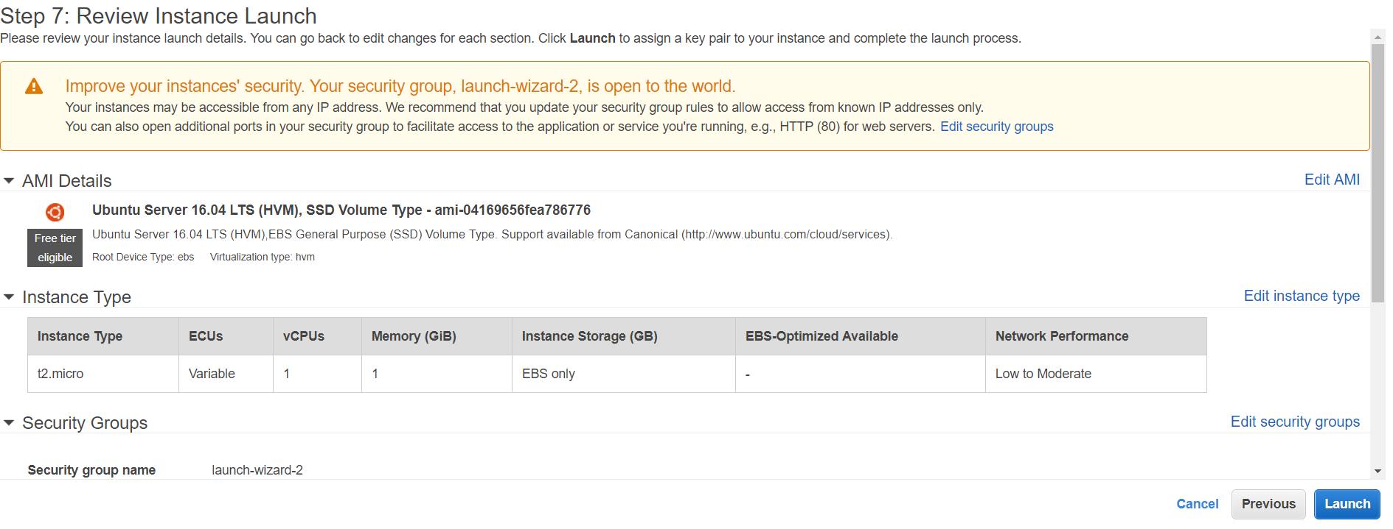
Review Instance Launch
So after you have finalized your instance details, you can launch it
After you click on “Review and Launch”, you will land into the page shown below.
Now just “Launch” your instance.

Slide 17
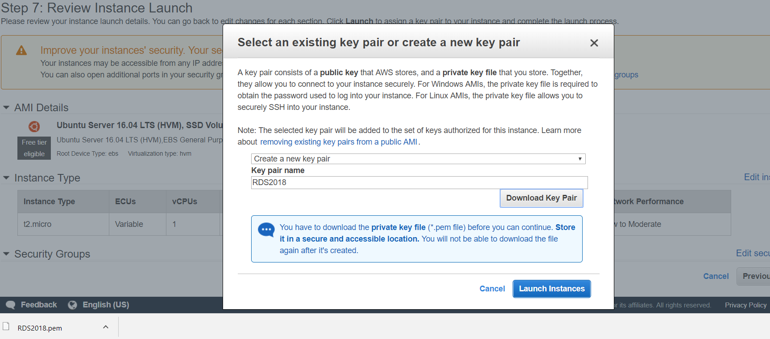
Creating a key pair
Before you can launch your Instance, you need to create a key pair.
Just name a key pair, I have named mine “RDS2018”
Now download your key pair and save it somewhere. You will need it at a later time for login.
You will use this key to login into any instance you create in the future.

Slide 18
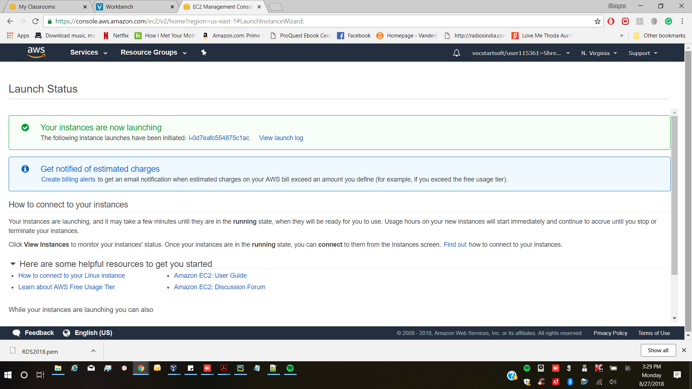
Launch Instance
After you have created a key pair and saved it, launch your instance.
On the bottom right you see “View Instances”, select it.
This will take you back to EC2 dashboard.

Slide 19
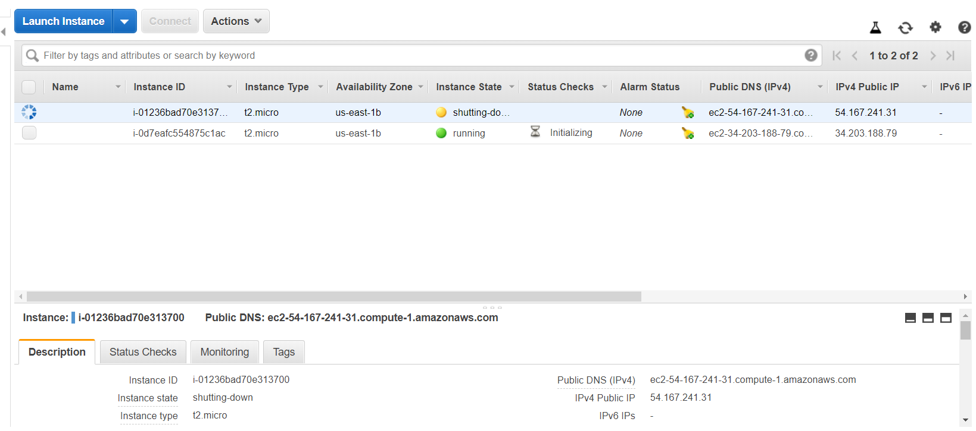
EC2 Dashboard
You can see your instances on the dashboard.
Once you have launched your instance, it may take some time for initializing before you can use it.
Public DNS is important, as you need it along with your key pair to login into your instance.

Slide 20
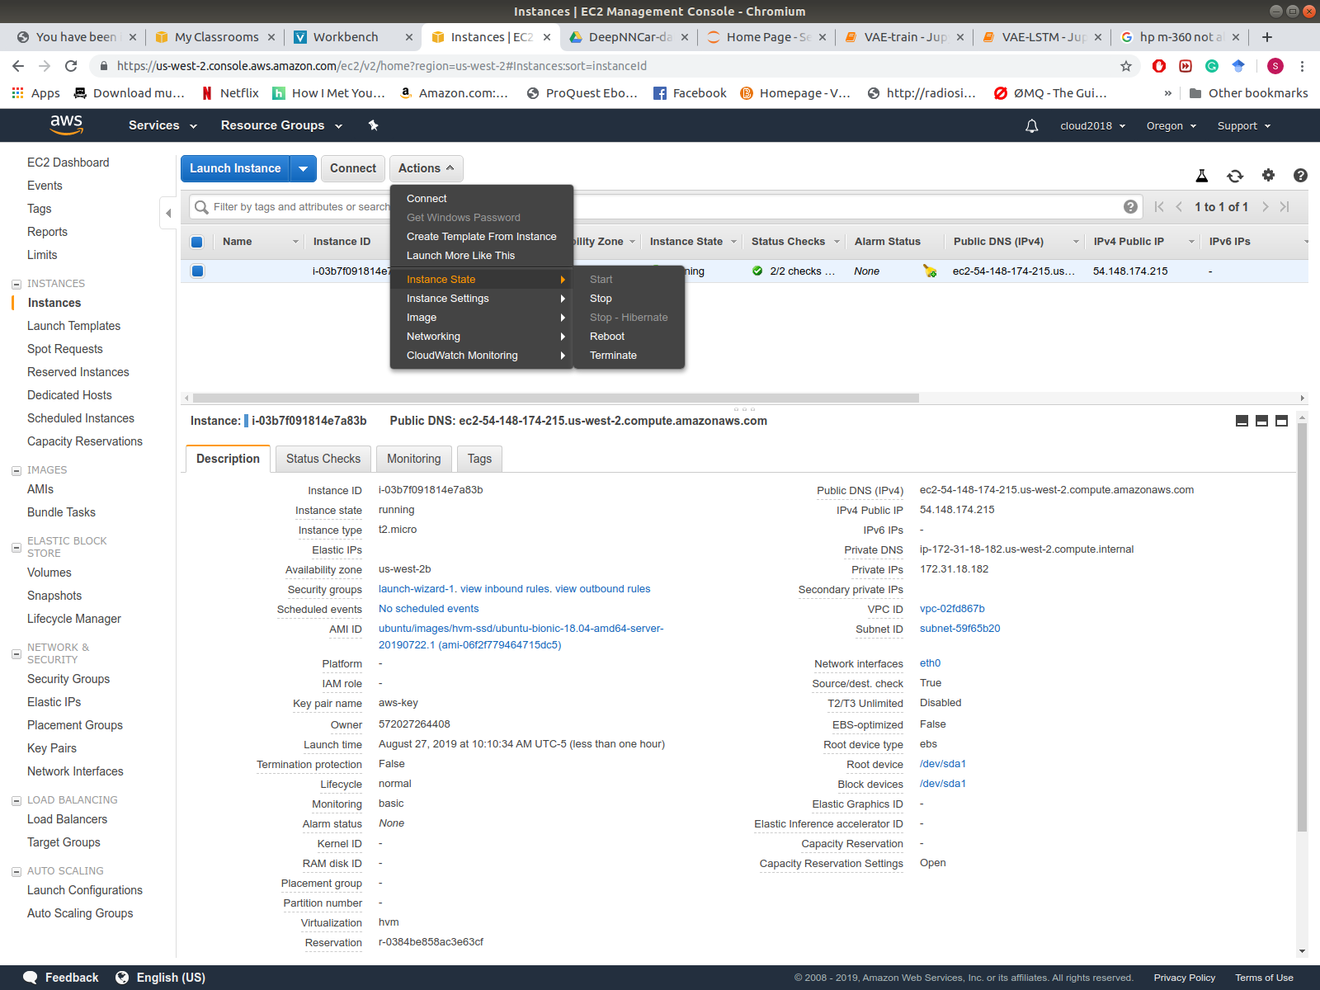
Stopping EC2 Instance
Always remember to stop your aws instance after work.
To start or stop EC2 instance go to: Actions → Instance State → Stop

Slide 21
SSH for connecting to EC2 instance (Ubuntu)
Resilient Distributed System
Fall 2019

Slide 22
SSH to EC2 instance
Open a terminal on your Ubuntu Desktop/VM.
Type: ssh –i aws-key.pem ubuntu@ec2-18-236-163-10.us-west-2.compute.amazonaws.com
This will get you access to the EC2 instance.

Slide 23
PUTTY for connecting to EC2 instance (Windows)
Resilient Distributed System
Fall 2019

Slide 24
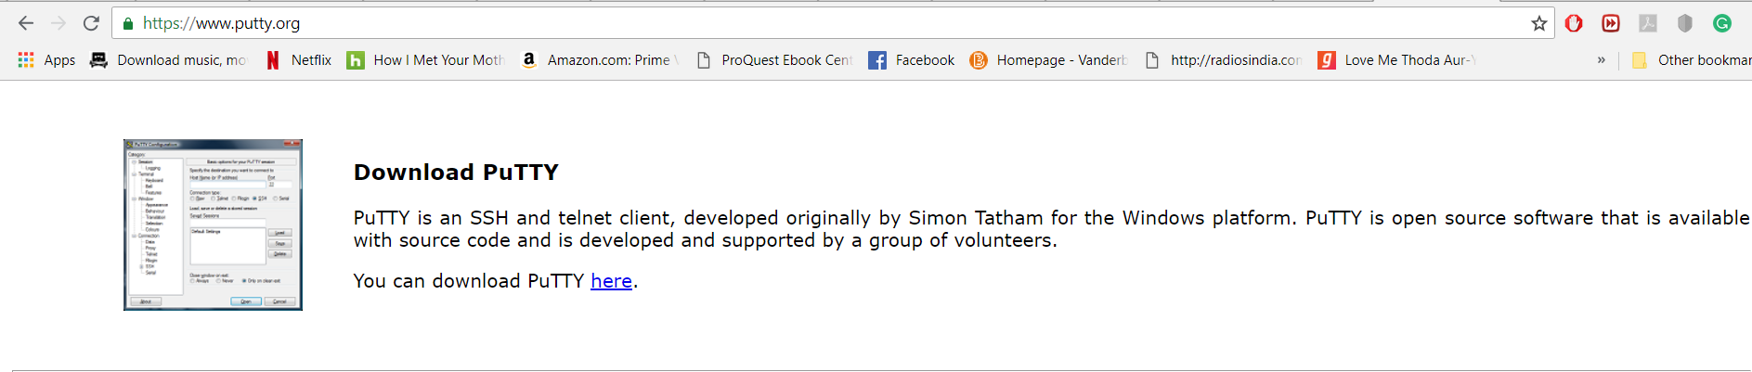
Download PUTTY
Putty is used to connect to your EC2 instance.
Download it from https://www.putty.org/

Slide 25
Download PuTTY
PuTTY is used to connect to your EC2 instance.
Download it from https://www.putty.org/

Slide 26
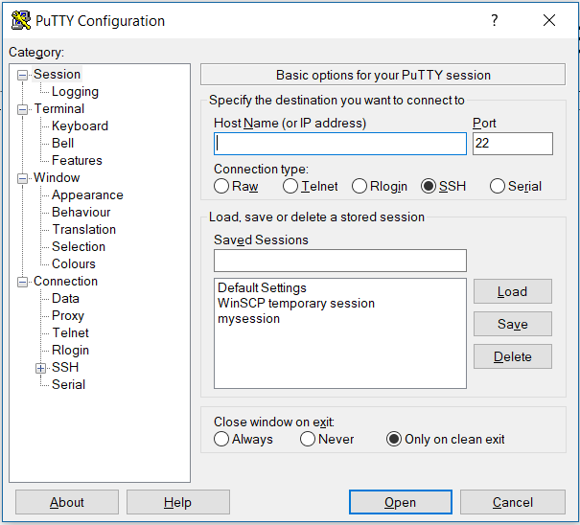
PuTTY
Once you have downloaded PuTTY successfully, it looks like this.

Slide 27
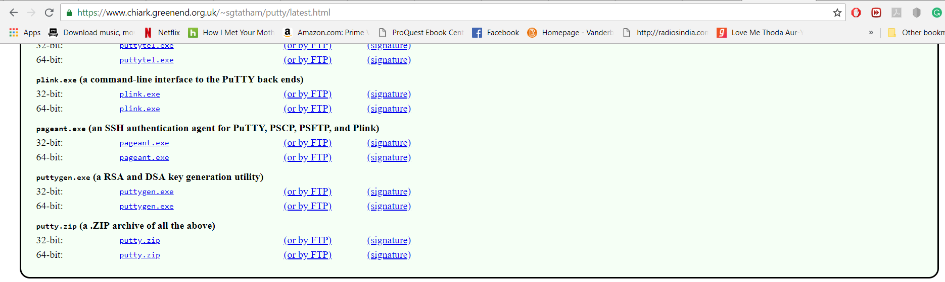
Download Puttygen for private key
The key which was generated by aws (RDS2018.pem) will not be recognized by putty.
You need to convert this into a private key for logging into the instance.
For converting the default public key to a private key, you need to use a tool called puttygen.
Download from https://www.chiark.greenend.org.uk/~sgtatham/putty/latest.html

Slide 28
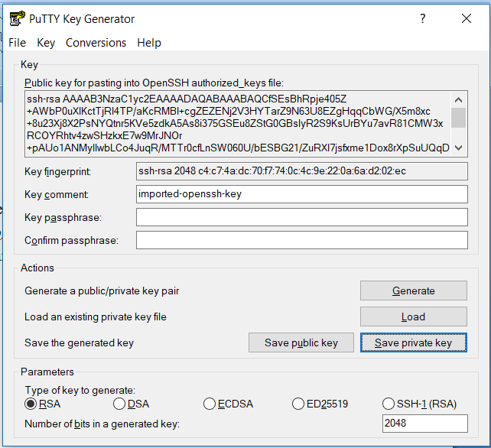
Generating Private key
After downloading Puttygen, we can convert the default key to a private key.
The default key has extension .pem and we will convert it into .ppk
Open Puttygen, it looks like the image shown below.

Slide 29
Generating Private key
Here “Load” the .pem file (RDS2018.pem)
Then select “Save private key”, this will pop up a warning as you do not have a key phrase set up.
I am not setting it up, you can set it up if you want. It is another wrapper of security.
So you can save the .pem (RDS2018.pem) file. This file will be used for connecting to the EC2 instance.

Slide 30
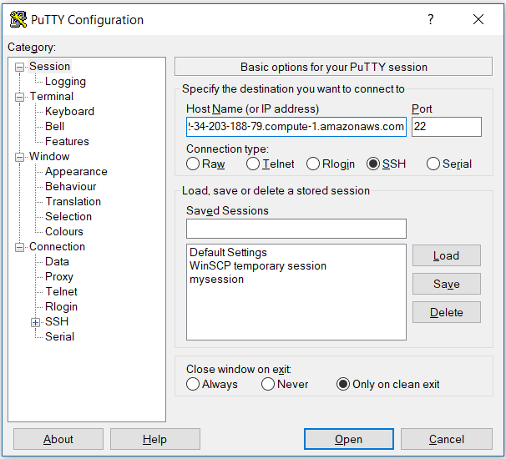
Logging into Instance
In the Host Name block copy the Instance’s Public DNS.
Leave the Port number as it is.
After entering the IP, now select data at the bottom left.

Slide 31
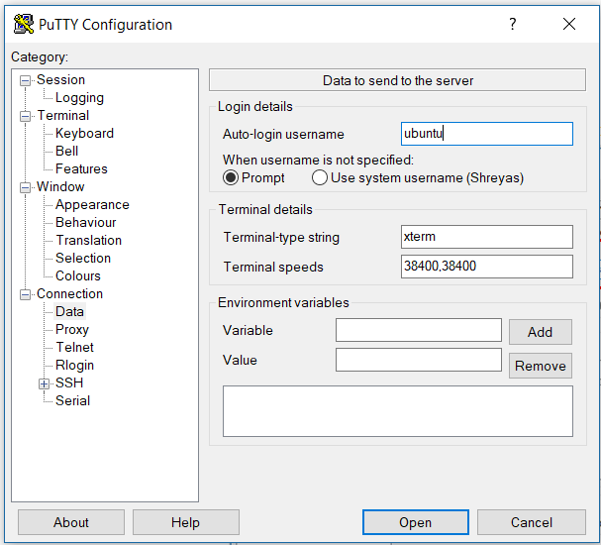
Logging into Instance
After entering the host name, you will have to enter the user name.
By default ubuntu instance has a username of “ubuntu”.
Enter this in the user name block.

Slide 32
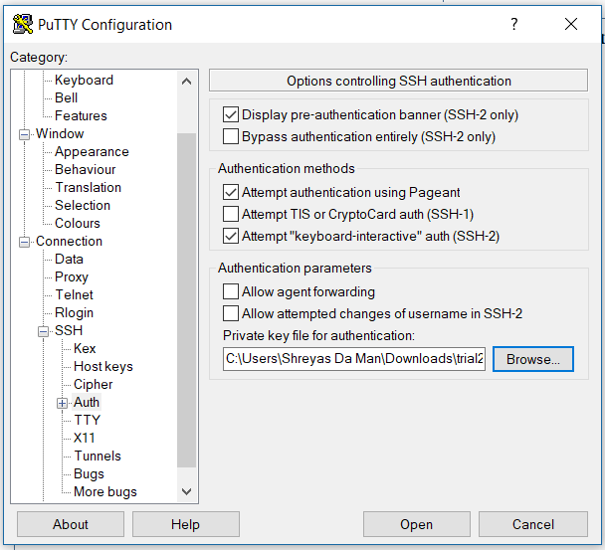
Getting back to Putty
The .ppk key generated from puttygen will be used for connecting to your instance.
Now expand on SSH (click on +), which is on the bottom left.
From there select “Auth”, here you need to add your .ppk file. Browse it.
After adding the private key, click on “open”

Slide 33
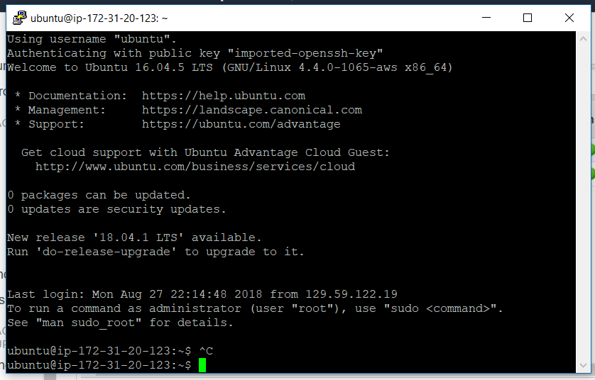
Your EC2 instance
If you have followed these slides correctly, then you will land into your EC2 instance as shown below.
Now you just use it as any ubuntu image to do your assignments.

Slide 34
References
Getting started tutorial from Amazon
https://docs.aws.amazon.com/AWSEC2/latest/UserGuide/EC2_GetStarted.html
Connecting to EC2 instance using SSH
https://medium.com/@GalarnykMichael/aws-ec2-part-2-ssh-into-ec2-instance-c7879d47b6b2
Copying files between local machine and ec2 instance https://forums.aws.amazon.com/thread.jspa?threadID=64703
Connecting to EC2 instance through PUTTY
https://docs.aws.amazon.com/AWSEC2/latest/UserGuide/putty.html?icmpid=docs_ec2_console
https://www.youtube.com/watch?v=bi7ow5NGC-U
Copying files from your laptop to EC2 instance
https://angus.readthedocs.io/en/2014/amazon/transfer-files-between-instance.html

